Slide 1
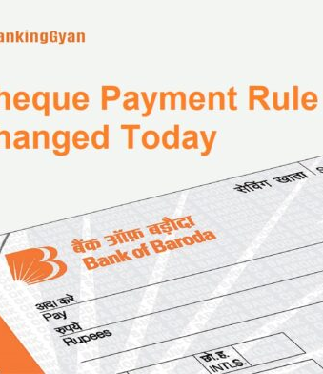


Bank of Baroda Hackathon - 2022
TEAM EMINENCE
WE EMINENCE ARE TECH FANATIC.WE LOVE EXPLORING AND LEARNING NEW THINGS.
Date :20TH SEP 2022

Slide 2
Automated Cheque Processing

Slide 3
Problem Statement ?
Encashing these cheques involves manual cheque verification and processing which consumes time and even misleads sometimes.
To reduce manual mediation and develop a effective,flexible and versatile system that can accepts cheques as input and classifies it into genuine or forged,protecting Bank and Customer both from fraudulent cheques.
After synchronizing our product with the Bank of baroda application ie BOB World,Bank will able to verify cheques with maximum accuracy and in minimum time using less human resources,making cheque processing system swift and safe both for bank and customer.

Slide 4
User Segment and Pain Points
Automatated verification system is available to user 24 x 7, manual cheque depositing process is constrained by working hours of bank.
Cheque read incorrect is difficult to deal with in terms of cost and time.
Many banks automatically process cheques under a certain value,putting tham a risk of accepting forged cheques.

Slide 5
Pre-Requisite
There is no such alternatives as of now,Most of the banks still follow the manual cheque clearing process.
Manual cheque requires user written information including date, signature, legal and courtesy amounts present on cheque to be visually verified by intermediaries.
Unlike automated verification,this process is cumbersome and takes couple for actual transfer of money

Slide 6
Azure tools or resources.
Azure Cloud will be used to store Customer ICMR code, cheque numbers and signatures.
Azure SQL database will be used to retrieve the above data for automation verification process.
Azure Customer stories will be used for the research work and better product optimization.

Slide 7
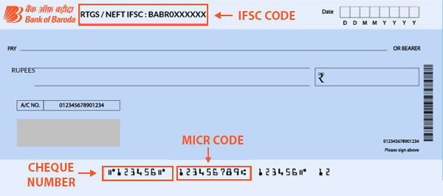
How a bank verifies a cheque Manually
MICR Code- 9-digit code that
uniquely identifies the bank and
branch.
Cheque Number- 6-digit number
uniquely assigned to each cheque
leaf.
Cheque Signature-Signature of the
cheque holder.
Manual Verification- Bank verifies
manually by calling to the drawee if the amount is big.
Bank even verifies the drawer by verifying its documents.

Slide 8
Key differentiators and Adoption plan
Many banks automatically process cheques under a certain value, putting them at risk of accepting forged cheques.
Automated verification system authenticates cheques with high precision protecting both bank and customers from potential fraud.
Manually perform spot checks and look at checks over certain values, a process which ultimately wastes both time and money.
Automated signature verification gives affordable and virtually effortless way to verify the signatures on checks, regardless of their face value.

Slide 9
AUTOMATED CHEQUE PROCESSING SYSTEM
Automated check processing will follow the same working principle as physical check clearing.The only difference is that the process is automated.
When there is a huge number of bank cheques are needed to be verified manually.This challenging task leads to the dire need of a robust automated computerized verification system for offline signatures, which is capable of distinguishing among the genuine and forged offline signatures with accuracy and speed automatically.
Manual offline signature verification of a large number of documents is time-consuming and depends on human vigilance, experience and expertise to detect a signature forgery.

Slide 10
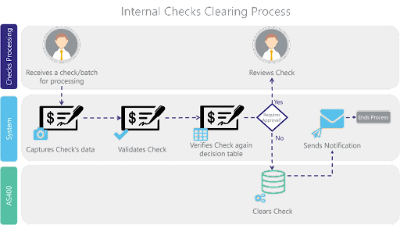

Slide 11
Automated cheque processing using Deep learning
The basic aim of any machine learning-based offline signature verification system to distinguish the genuine offline signature from the forged one automatically.
The offline signature’s inherited dynamic information is collected with a sequence of time intervals.
The goal is to learn from a large population of genuine and forged signature samples. The focus is on differentiating between genuine-genuine differences and genuine-forgery differences.
Using Scott and Longuet-Higgins algorithm point-to-point matching can be constructed between two point sets while ignoring some bad matches.

Slide 12
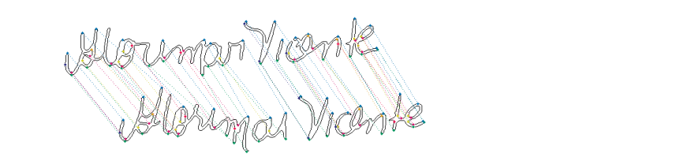
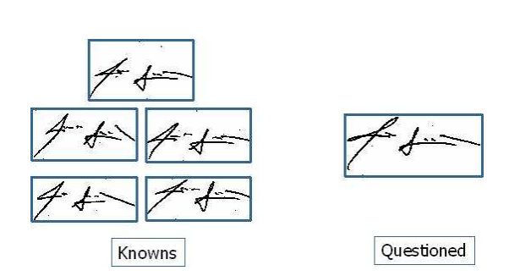
The verification task is performed by comparing the questioned signature against each known signature.

Slide 13
Automated cheque processing using Open cv
Through this method the manual task of verifying data is minimized.
The Scanned data is passed to OpenCV which returned the various parts of the cheque which were then passed to Google Vision API to convert them into text, but MICR code was passed to tesseract OCR.
Optical Character Recognition (OCR) will be performed on this Region of Interest and data will be read from cheque. According to the results of the OCR further transactions will be executed.

Slide 14
Automated cheque processing using Image processing
The image is captured using android device’s camera.
The captured image suffers from number of limitations like geometrical distortions, insufficient brightness, folded or torn cheque corners and edges, skewed image etc.
In preprocessing phase, we convert the image into gray scale; adjust its brightness and contrast.
We apply different filters to reduce noise from the image.
This image is sent to Tesseract for optical character recognition. The preprocessed image increases the accuracy of Tesseract noticeably.

Slide 15
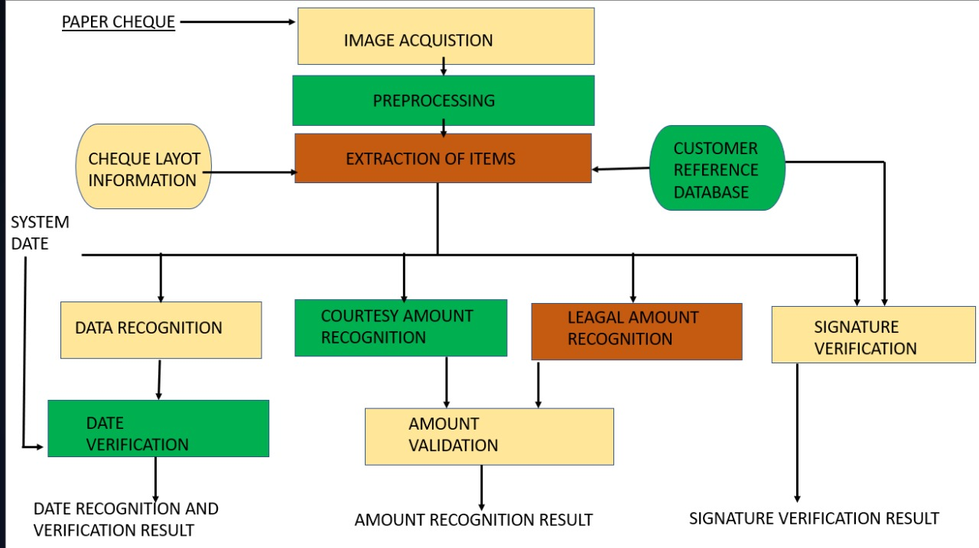
Supporting diagrams

Slide 16

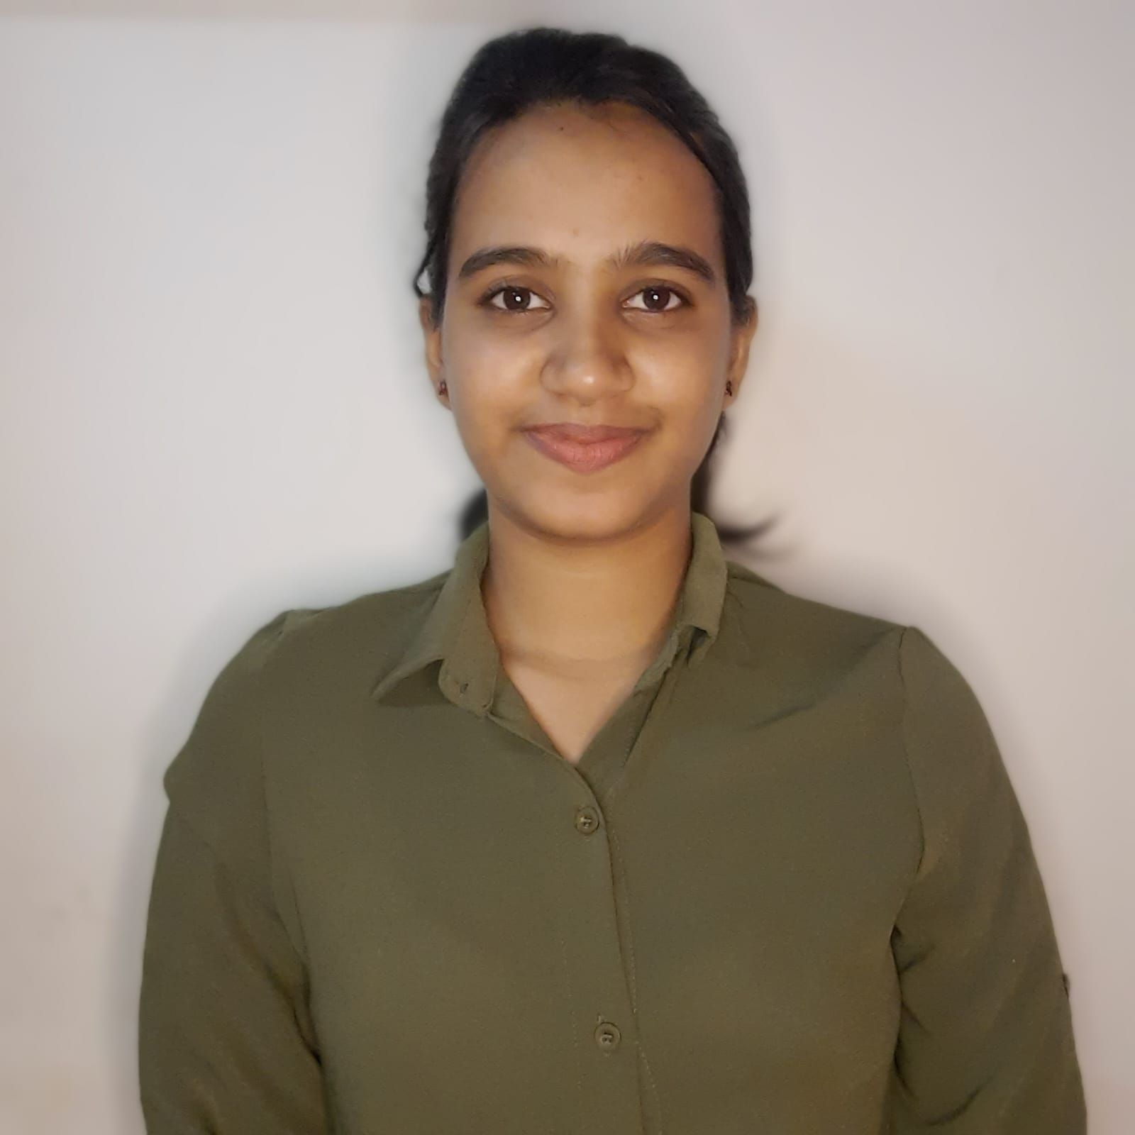


TEAM EMINENCE
RAJ GAURAV
TRIPTI SINGH
TITHI SINGH
SHIBASISH PRIYABRAT

Slide 17
Thanks!
Any questions?
You can find me at:
rajgaurav2k21@gmail.com

